Slide 1


Model analysis and visualization of 6PPD-quinone fate and transport in Longfellow Creek watershed, Seattle, USA
Robert McKane¹, Jonathan Halama², Vivian Phan¹, Allen Brookes¹, Kevin Djang³, Edward Kolodziej⁴, Katherine Peter⁵, Zhenyu Tian⁴
¹ US Environmental Protection Agency, Pacific Ecology Systems Division, Corvallis, OR, USA
² Spatial Synergy Solutions, Independence, OR, USA
³ Inoventures LLC, c/o U.S. Environmental Protection Agency, Corvallis, OR, USA
⁴ University of Washington Center for Urban Waters, Tacoma, WA, USA
⁵ National Institute of Standards and Technology, Charleston, SC, USA
We gratefully acknowledge financial support for this research from US EPA Region 10 and the US EPA Office of Research and Development’s Safe & Sustainable Water Resources Research Program and Sustainable & Healthy Communities Research Program.
Disclaimer: The views expressed here are those of the author[s] and do not necessarily represent the views or policies of the US Environmental Protection Agency.
EMCON 2021
Notes:
Hello and thanks for the opportunity to present our research on “Model analysis and visualization of 6PPD-quinone fate and transport in Longfellow Creek watershed, Seattle, USA”
Thanks to all the authors – each has contributed in crucial ways to the work presented here.
Grateful acknowledgements for financial support and collaboration go to EPA Region 10 and EPA-ORD’s research programs for Safe and Sustainable Water Resources and Sustainable and Healthy Communities
I am Bob McKane and I’ll be narrating today’s presentation along with teammate Jonathan Halama.

Slide 2
Animated Slides…
Use Slide Show View to see animation
Use Normal View to see explanatory Notes

Slide 3
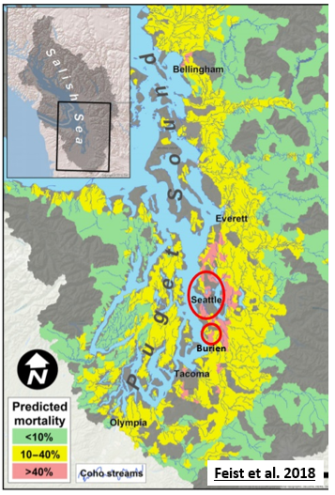
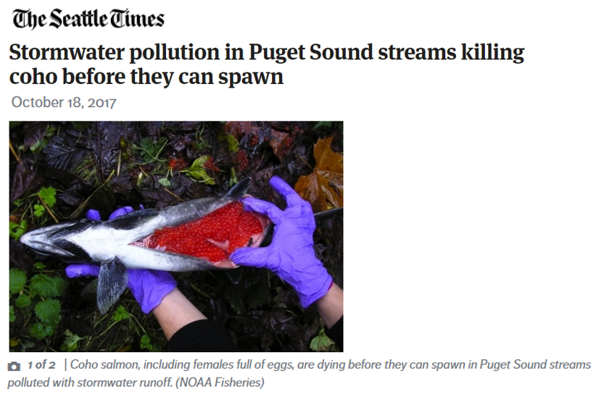
What’s killing the coho?
A decades-long mystery
US EPA Office of Research and Development
Center for Public Health and Environmental Assessment, Pacific Ecological Systems Division
3
Notes:
We begin with a decades-long environmental mystery: What’s killing the coho salmon in Puget Sound lowland streams?
For millennia adult coho have made their annual fall migration from Puget Sound into freshwater streams to spawn.
Unfortunately, a high percentage of coho die before they can spawn, contributing to historically recent steep declines in their population.
This map at right shows coho prespawn mortality is especially high in stream withing densely populated urban areas such as Seattle….
…with prespawn mortality rates as high as 40 to >90% of all spawners (red areas).

Slide 4
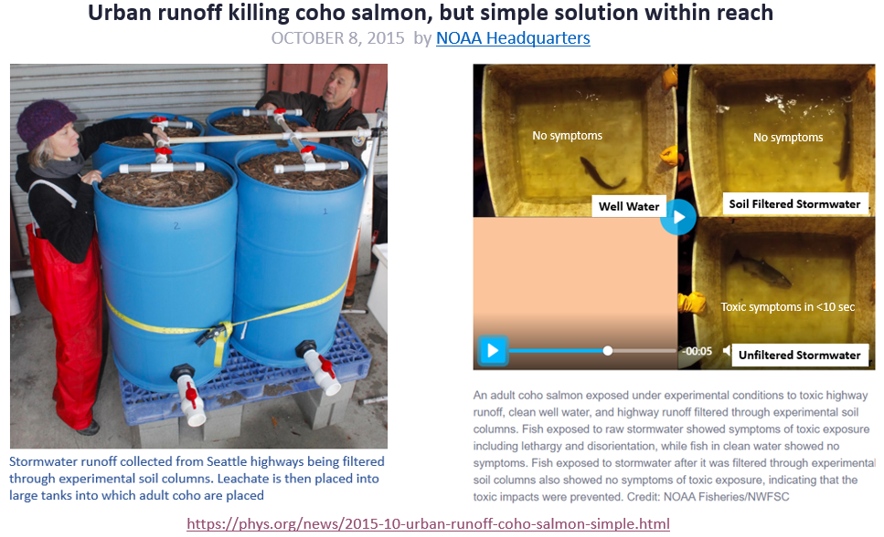
A key demonstration of the effectiveness of green infrastructure treatments,
such as rain gardens, bioswales, riparian buffers, pervious pavements…
https://phys.org/news/2015-10-urban-runoff-coho-salmon-simple.html
US EPA Office of Research and Development
Center for Public Health and Environmental Assessment, Pacific Ecological Systems Division
4
Notes:
This mystery has been intensively studied by many investigators and institutions over the years.
Key early findings were that coho prespawn mortality was correlated with
Exposure to toxic urban stormwater runoff
Coho do fine when stormwater runoff is filtered through soil columns set up as experimental rain gardens...
But die very quickly when exposed to unfiltered stormwater
This study was a key demonstration of the effectiveness of green infrastructure treatments, such as rain gardens, bioswales, riparian buffers, pervious pavements…
However, the specific toxicant or toxicants responsible remained unknown, until last November…

Slide 5
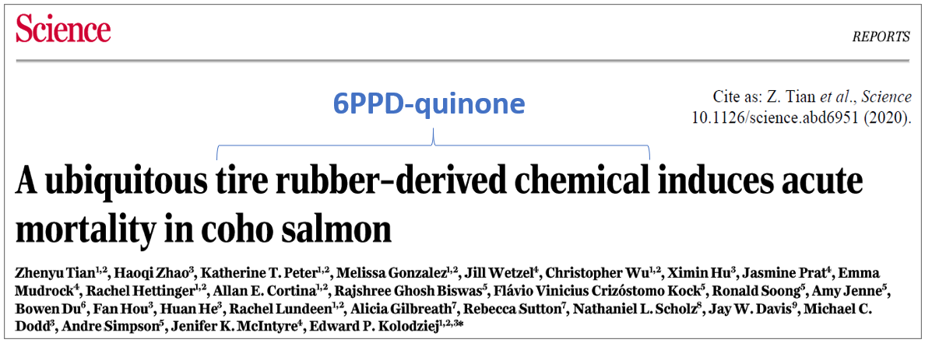
Mystery Solved…Tian et al. 2020
US EPA Office of Research and Development
Center for Public Health and Environmental Assessment, Pacific Ecological Systems Division
5
Notes:
In this 2020 Science paper, Tian et al. used advanced mass spectrometry methods to identify a specific tire-rubber derived chemical - 6PPD-quinone – responsible for coho prespawn mortality.
Their study is a classic example of forensic ecotoxicology that leveraged past and present field and laboratories studies by the community of authors listed to solve this mystery.

Slide 6
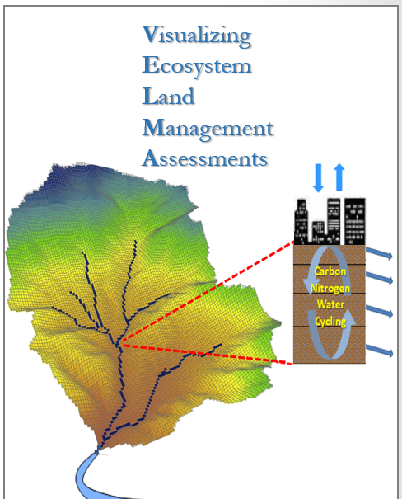
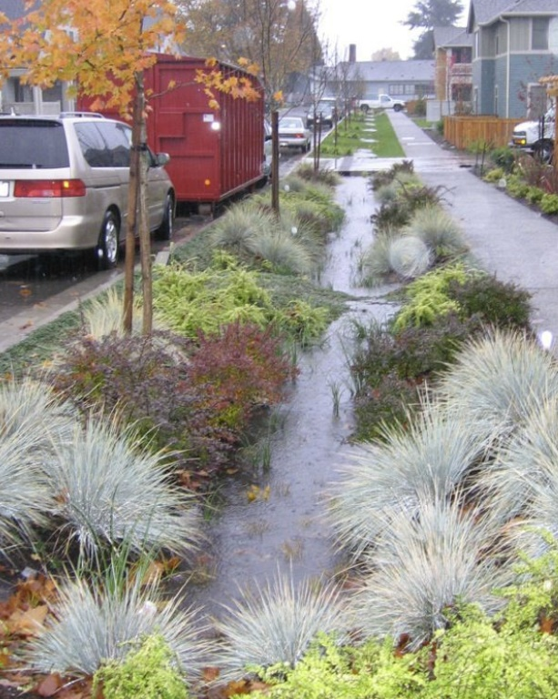
VELMA Ecohydrology Model
Estimate: Contaminant Fate and Transport in Urban and Rural Watersheds: Organics, Nutrients, Metals
Inform: Options for Reducing Toxic Chemicals in Stormwater Via Green and Gray Infrastructure
Support: Clean Water Act, CERCLA, National Pollutant Discharge Elimination System, Endangered Species Act, H.R.4266-Clean Water Through Green Infrastructure Act
VELMA v2.1 includes open-source software, user manual and demos quantifying contaminant fate and transport & mitigation strategies
US EPA Office of Research and Development
Center for Public Health and Environmental Assessment, Pacific Ecological Systems Division
6
Notes:
So, where to now, knowing what we know now about 6PPD-quinone’s role and potential remediation of its impact on coho through green infrastructure implementations?
Our team at the EPA-ORD laboratory in Corvallis, Oregon, developed the VELMA Ecohydrology model to help address this question.
VELMA is a spatially-explicit, grid-based model that links hydrological and biogeochemical processes in watersheds.
REGION 10…..Two relatively recent modifications to VELMA include the addition of
A contaminant fate and transport model for Estimating fate and transport of nutrients and toxicants in urban and rural watersheds, and
Adaptations for simulating deposition and runoff of urban stormwater pollutants via roads, drains, pipes, and other urban landscape features.
Our goal is to verifiably inform Options for reducing loadings of toxic chemicals in Stormwater Via Green and Gray Infrastructure, ….
as illustrated by green infrastructure measures such as this bioswale in the High Point neighborhood of West Seattle.
This goal aims to Support community, tribal, state, and federal efforts to protect freshwater and marine water quality and species of concern.
At this point I would like to turn the mic over to VELMA teammate Jonathan Halama for an overview of model results describing preliminary tests of VELMA for simulating green and gray infrastructure effects on fate and transport of 6PPD-quinone in the Longfellow Creek watershed, Seattle’s 4th largest urban watershed, and a site of very high rates of salmon prespawn mortality.

Slide 7
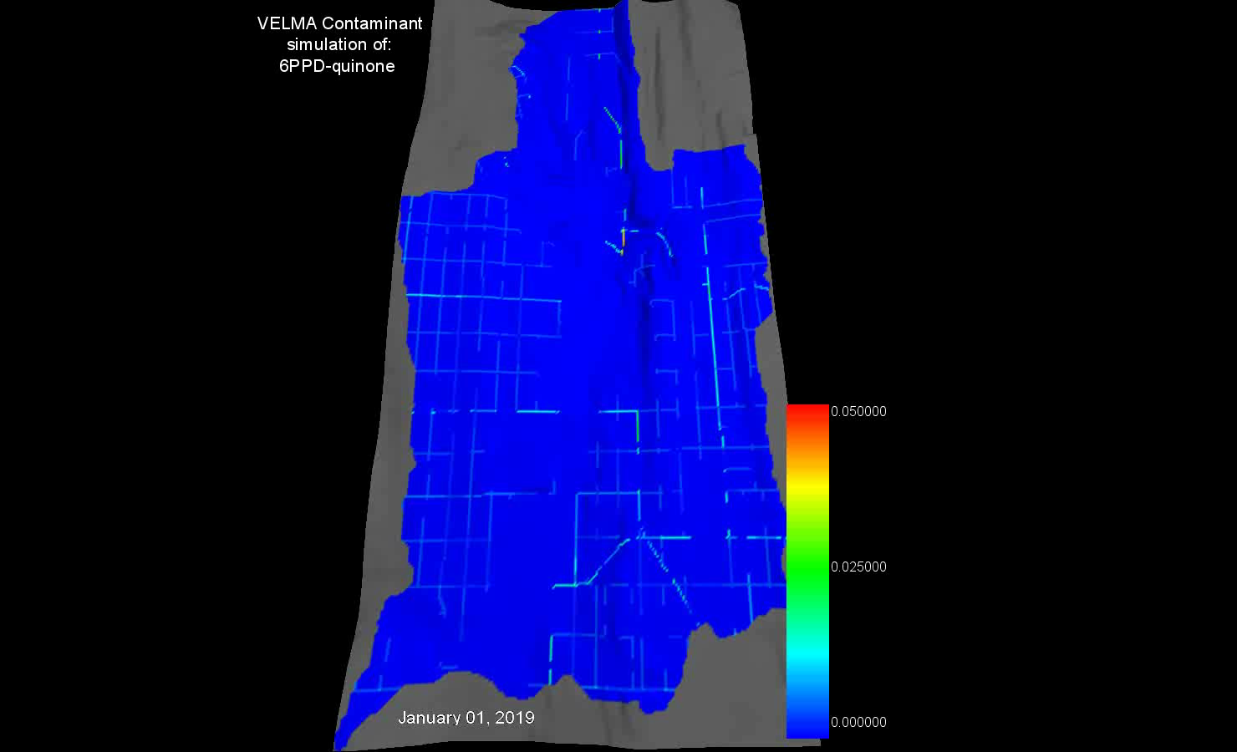
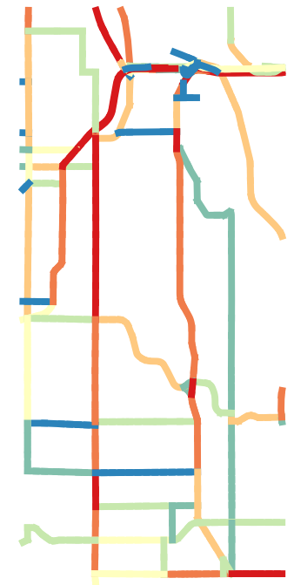
Daily 6PPD-quinone g/m² based on observed traffic flow patterns (WSDOT + City of Seattle), tire wear particle deposition/km (Kole et al. 2017), and 6PPD concentration in TWP and its conversion to 6PPD-quinone (Tian et al. 2020).
Modeled 6PPD-quinone
g/m²
(reflecting balance of deposition & drainage)
g/m²/day
0.05
0.025
0.00
7
Notes:
In this VELMA animation, we are watching modeled daily fate and transport of 6PPD-quinone for one year in Longfellow Creek watershed.
This includes:
- Deposition of 6PPD contained in tire wear particles, as influenced by traffic intensity and spatial patterns
- Conversion of 6PPD to 6PPD-quinone and its subsequent transport along impervious roads during rain events…
- Until reaching stormwater drains and pipes and transport to outfalls near Longfellow Creek (low area running south to north indicated by darker shading, at left)
Red cells (right) = highest levels of 6PPD-quinone

Slide 8
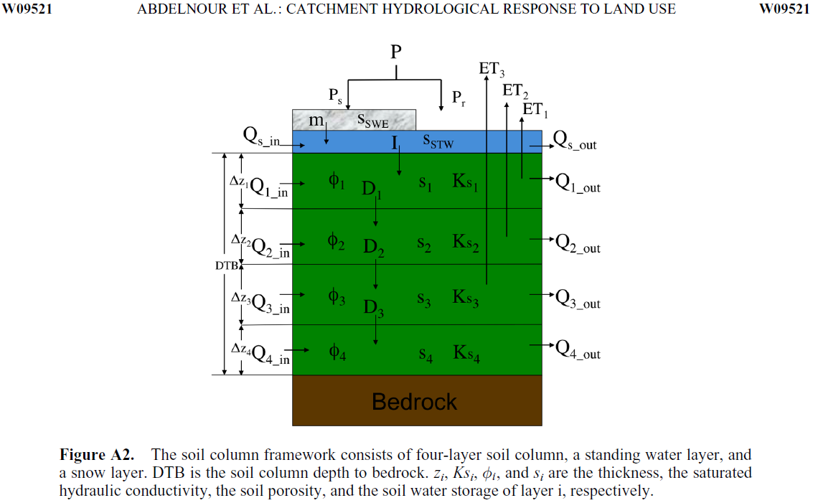
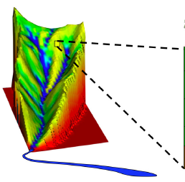
VELMA: Grid-based Urban Fate and Transport
Water & Chemical Transport
Daily precipitation
Surface layer perviousness (0-1)
Stormwater System
Spatially-explicit roads, curbs, drains, pipes
Transfers: curb to drain to pipe to stream…
Soil matrix (10-m grid)
Vertical and lateral flow (see figure)
Contaminant transport, decomposition, sorption, desorption, aqueous/solid phase mass balance
Perviousness
Stormwater
surface
US EPA Office of Research and Development
Center for Public Health and Environmental Assessment, Pacific Ecological Systems Division
8
Notes:
VELMA is a grid-based fate and transport model. Precipitation falls upon the soil surface layer (represented in blue), and either moves along the surface or moves vertically down into the soil matrix and then vertically from layer to layer, and laterally from cell to cell through the watershed, ultimately draining to the pour point.
For urban applications, the surface layer can be represented as impervious for roads, roofs, etc, or partially or fully pervious for more natural cover types.
Impervious roads can be represented with curbs, in which case stormwater water is contained and directed to flow into stormwater catchments (drains) and pipes and to an outfall location. Ideally, all these features can be georeferenced using publicly available data (true for most Seattle urban watersheds).
Depending upon where contaminants are deposited – e.g., on roads or pervious surfaces – contaminant transport is controlled by:
The flow of water along impervious surfaces to drains and pipes.
And/or subsurface water flow and the degree of contaminant sorption and decomposition within the soil matrix.

Slide 9
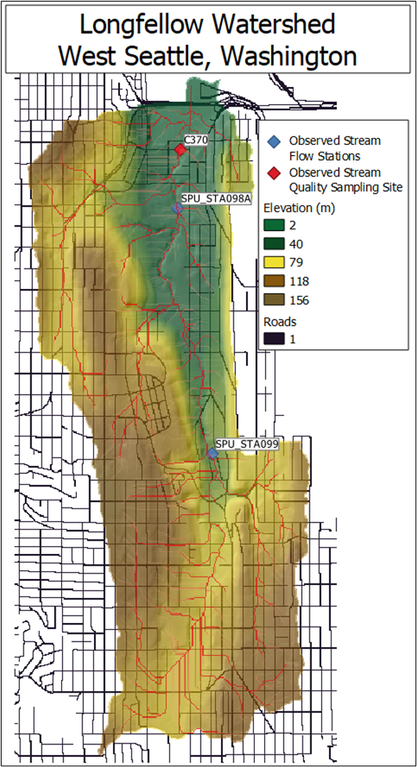
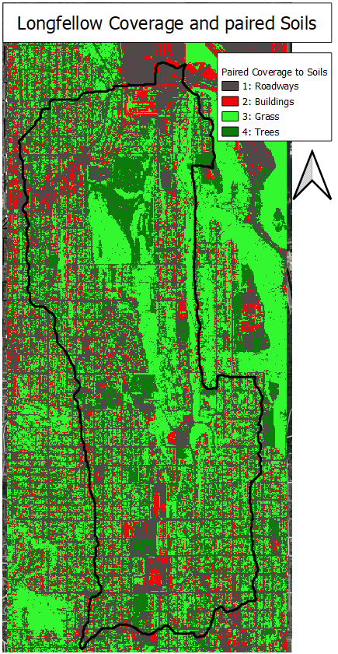
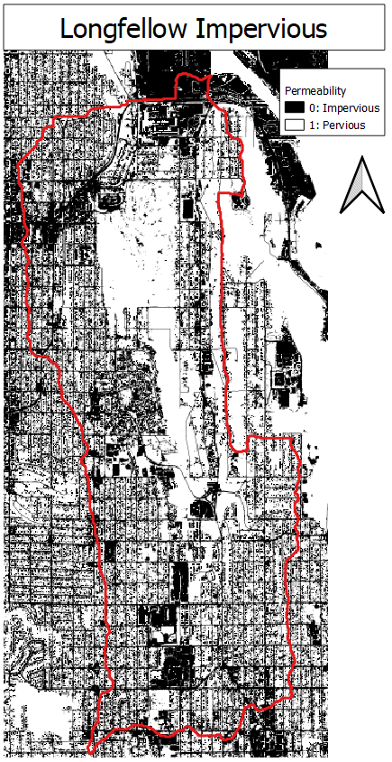
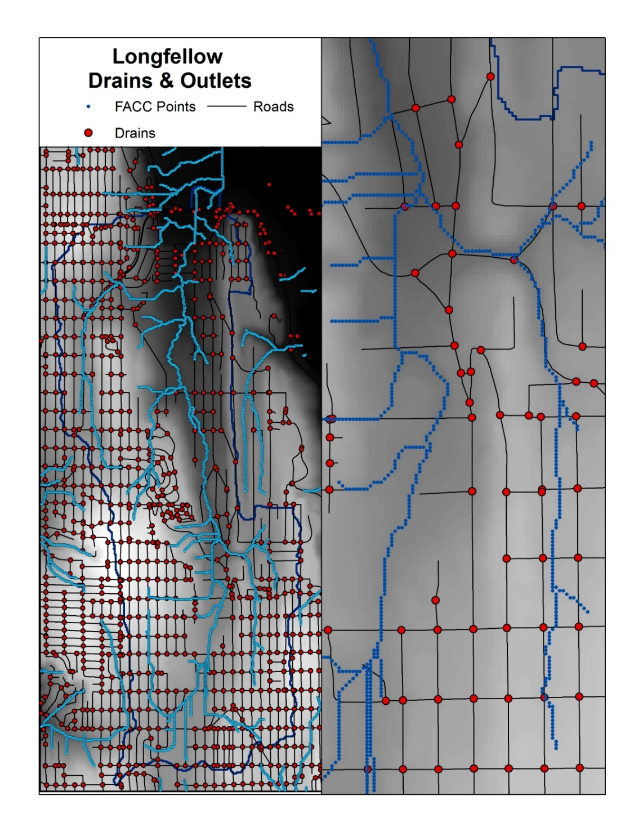
VELMA Urban Setup: Major Spatial Components
Flow paths
Roads
Drains
Longfellow Creek
US EPA Office of Research and Development
Center for Public Health and Environmental Assessment, Pacific Ecological Systems Division
9
Notes:
For this presentation we are focusing on modeling 6PPD-quinone fate and transport in the Longfellow watershed, West Seattle, Washington. This series of maps illustrate data requirements for the Longfellow landscape with regards to elevation (left); coverage for buildings, grass, trees (2nd from left); roadways and other impervious surfaces (3rd from left); and data for developing the storm water system in VELMA (far right).

Slide 10
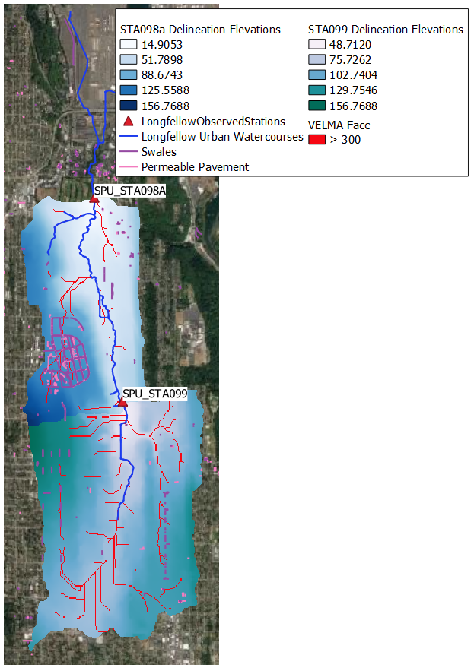
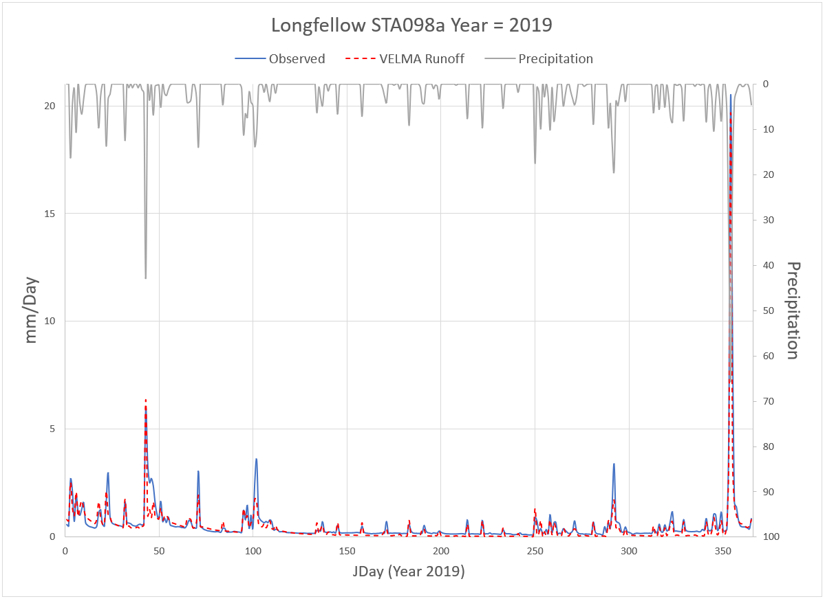
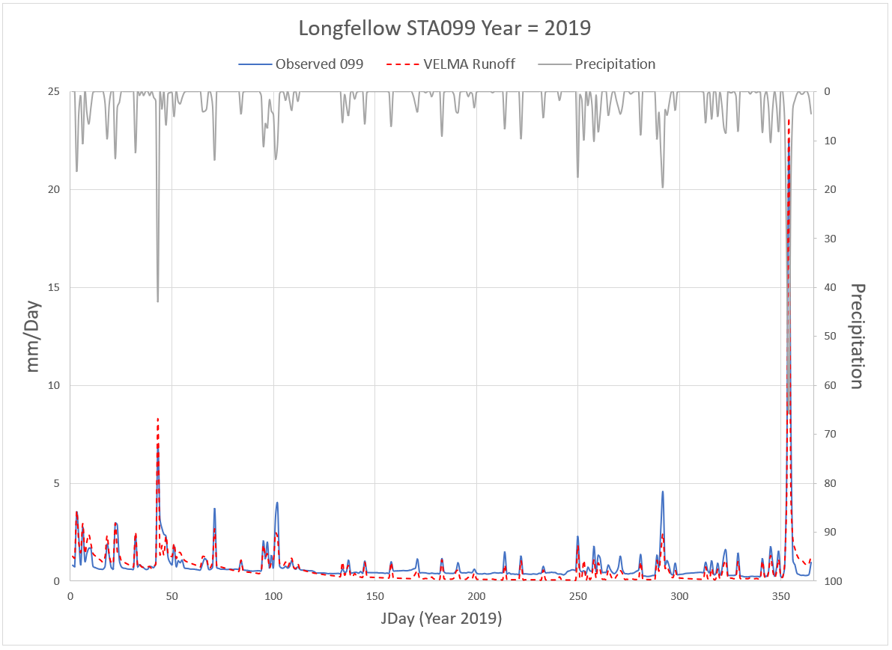
VELMA urban stormwater runoff performance tests
ANIMATED – USE SLIDE SHOW VIEW
Longfellow Creek Stream Gage #STA098a, Year = 2019
Precipitation
Longfellow Creek Stream Gage #STA099, Year = 2019
Year | NSE | Total Difference (sim-obs)
2019 | 0.90 | -53.4 mm/year
2020 | 0.72 | -5.9 mm/year
Stormwater runoff mm/day
Precipitation mm/day
Precipitation
Observed runoff
Stormwater runoff mm/day
VELMA runoff
Precipitation mm/day
Observed runoff
Julian Day 2019
VELMA runoff
Julian Day 2019
Watershed = 10.9 km²
US EPA Office of Research and Development
Center for Public Health and Environmental Assessment, Pacific Ecological Systems Division
10
Notes:
Model performance tests within this watershed showed that simulated stormwater runoff closely matched the observed runoff for Longfellow Creek. Observed data in the graph (blue line at left) is in blue for stream gage station 098a, the furthest downstream (north) gage location in Longfellow, versus VELMA's simulated runoff data in the (dashed-red line). Overall, VELMA is matching the low flows and peak events very well for this watershed, with an excellent goodness-of-fit Nash-Sutcliffe Efficiency (NSE) of 0.90 for 2019, and a respectable 0.72 in 2020. Similarly, for the furthest upstream (south) gage station 099, VELMA again performs well, still hitting most of the peak storm events quite well, but with summer low flows a bit high compared to observed values.

Slide 11
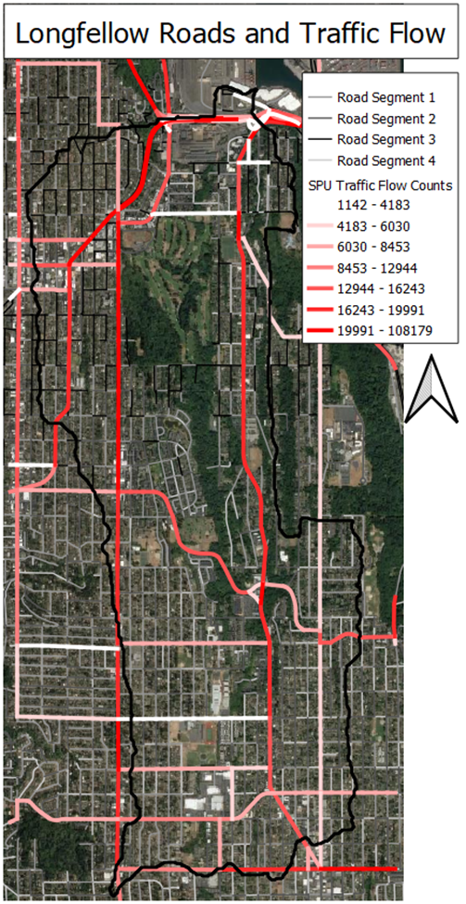
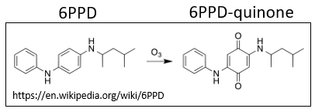
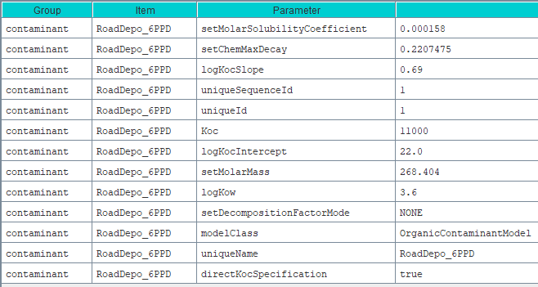
VELMA 6PPD calibration setup
6PPD deposition, degradation to 6PPD-quinone
6PPD location, timing, amount
Fraction to 6PPD-quinone
Parameters: 6PPD fate and transport
*
*
NA
*
NA
*
*
*From EPA CompTox Database https://comptox.epa.gov/dashboard
US EPA Office of Research and Development
Center for Public Health and Environmental Assessment, Pacific Ecological Systems Division
11
Notes:
Inclusion of a contaminant in VELMA is a two-part process. The first part is a disturbance input file that represents the cell-by-cell location of deposition, the daily timing, and the amount of 6PPD-quinone deposited (simulated as a fraction of a tire rubber that is 6PPD, and the fraction of 6DDP converted to 6PPD-quinone).
Characterization of daily spatial patterns of 6PPD deposition are based on a combination of daily traffic flow counts from the Washington Department of Transportation (high-traffic roadways) and Seattle Department of Transportation (neighborhood roadways).
Contaminant-specific information on 6PPD solubility, sorption, decomposition, and other chemical properties was obtained from EPA’s CompTox database (https://comptox.epa.gov/dashboard/dsstoxdb/results?search=DTXSID9025114).
Contaminant fate and transport within soil columns (grid cells) and watersheds is modeled through the interaction of Comptox parameters with hydrological and soil biogeochemical processes in VELMA. Comptox provides empirically-determined parameter values and associated variability
For example: Soil carbon content is a key soil variable affecting contaminant sorption and must be specified based on available soil survey data (e.g., GSSURGO) and can be used as a treatment variable in explorations of alternative GI scenarios.
Note that contaminant transport in VELMA via urban stormwater systems (roadway curbs, drains, pipes) act to “short-circuit” the role of soils in retaining and decomposing contaminants before reaching streams and estuaries. This is especially important for traffic-related contaminants such as 6PPD-q. Modeled additions of bioswales and rain gardens in VELMA serve to redirect flow on impervious surfaces to roadside soils.
Simulated concentrations of 6PPD-quinone (ng/L) were calculated and compared to available observed stream data for grab samples collected by Zhenyu Tian at the same georeferenced location.

Slide 12
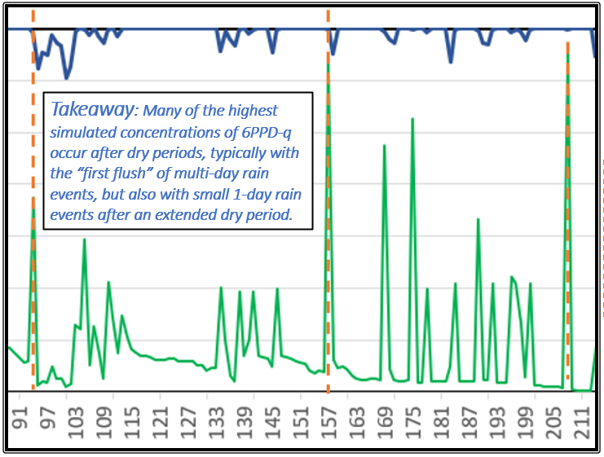
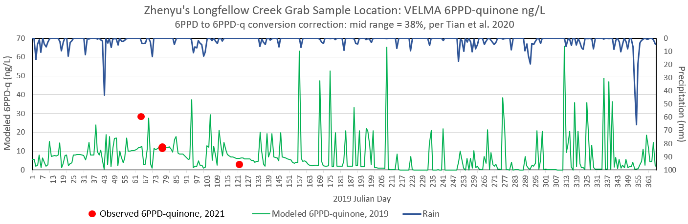
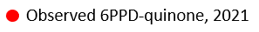
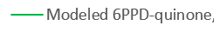
Longfellow Creek observed vs. Simulated 6PPD-quinone
ANIMATED SLIDE – USE SLIDE SHOW VIEW
VELMA Results
Longfellow Creek 6PPD-quinone stream concentrations
VELMA 6PPD-quinone ng/L @ Zhenyu Tian’s Longfellow Creek Stream Sample Location
No observed data are available for 2019, but VELMA is at least consistent with the observed 2021 data for this same location
12
Notes:
Here we are looking at 2019 daily VELMA model 6PPD-quinone runoff results to Longfellow Creek (green line) versus daily precipitation (blue line).
CLICK WHILE IN SLIDE SHOW VIEW TO SEE ANIMIATION 1 of 2: Modeled 2019 6PPD-quinone stream concentrations are very similar to 2020 observed data. This comparison of observed versus simulated 6PPD-quinone is at the same Longfellow Creek location where Zhenyu Tian collected 6PPD-quinone grab samples. Although no 2019 observed data are available, we're very happy that modeled results are in the same ballpark as Zhenyu’s 2020 samples. This suggests that our estimates for 6PPD-quinone deposition and fate and transport within the stormwater system and watershed are generally on target.
CLICK TO SEE ANIMATION 2 OF 2 to see the takeaway message concerning first flush behavior.
Comparison of the timing of 6PPD-quinone and precipitation peaks underscores 6PPD-quinone “first flush” behavior. That is, the concept of a contaminant building up on the roadway and a first flush stormwater runoff event occurring, such that higher levels of contaminants are being washed out very early during storm events (to left of peak runoff).

Slide 13
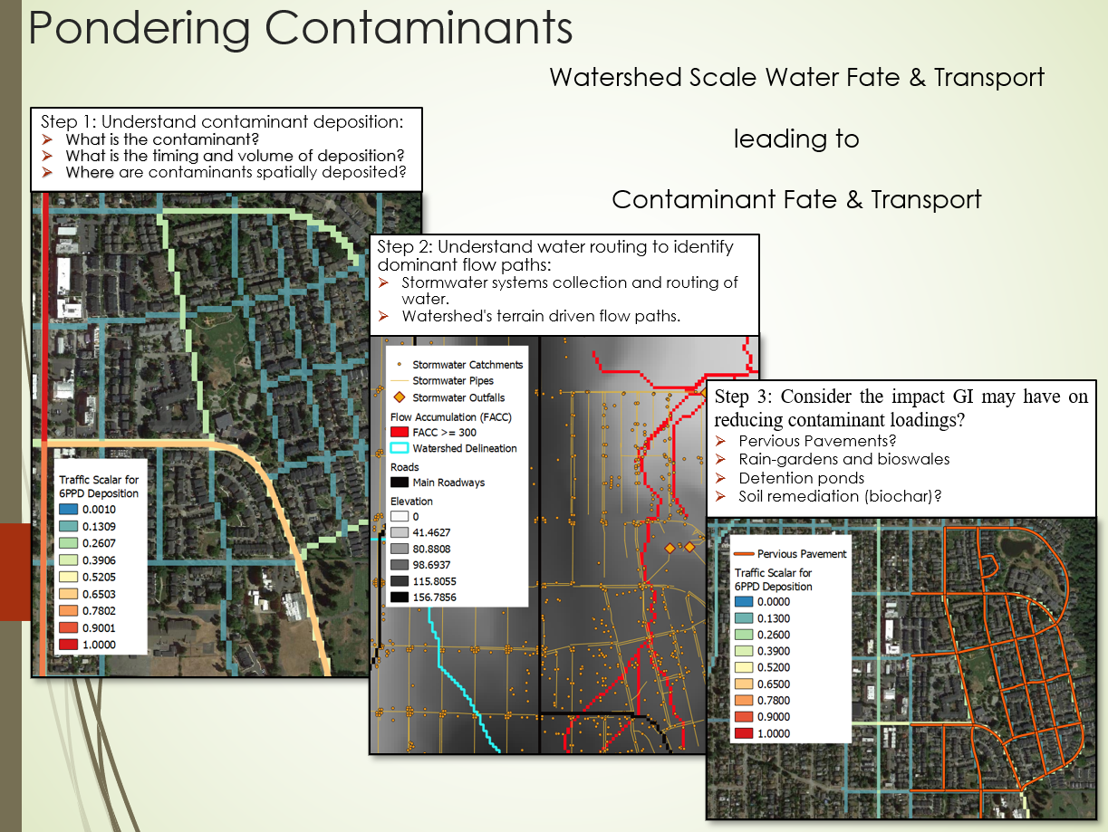
US EPA Office of Research and Development
Center for Public Health and Environmental Assessment, Pacific Ecological Systems Division
13
Notes:
This initial demonstration of VELMA’s ability to simulate 6PPD-quinone loadings in Longfellow Creek provides an opportunity to review the steps necessary to model contaminants in urban watersheds:
Step 1: Understand and characterize deposition of the contaminant in question: What is the contaminant source? What is the timing of the deposition and amount of deposition? What is the spatial pattern of contaminant deposition, and on what specific surfaces?
Step 2: Understand and characterize water routing. Where are the dominant flow paths.
Step 3: Given steps 1 and 2, where and what kinds of green and/or gray infrastructure treatments can be implemented to most effectively reduce contaminant loads.
Pervious pavements? Rain gardens? Detention ponds? Soil remediation (biochar)?

Slide 14
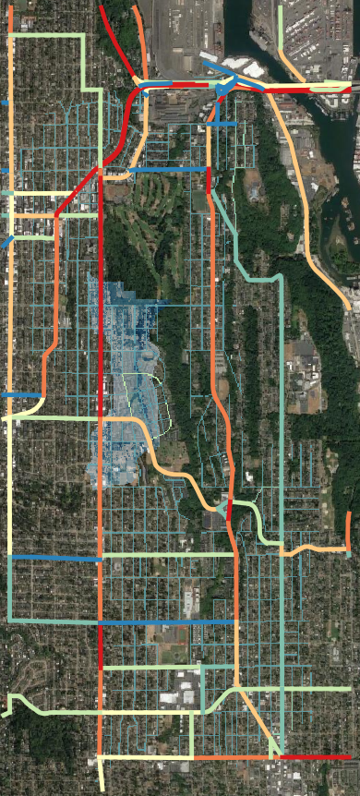
Model Scenarios: High Point Neighborhood*
Impervious roads everywhere
Impervious roads everywhere except actual pervious roads in High Point
Pervious roads everywhere
Pervious high-traffic roads, all others impervious
*High Point neighborhood in West Seattle (https://uli.org/wp-content/uploads/ULI-Documents/High-Point.pdf)
First community in Washington state to feature permeable pavements in residential streets, sidewalks, parking lots, sidewalks, courts.
On a site that was formerly 65 percent impervious, High Point’s natural drainage system infiltrates 75 to 80 percent of stormwater runoff.
LID Water management features: Bioretention swales, native plants or trees, natural drainage system, permeable pavers, rain gardens, retention pond.
Status: Opened 2004, planned completion 2018
US EPA Office of Research and Development
Center for Public Health and Environmental Assessment, Pacific Ecological Systems Division
14
Notes:
To demonstrate these ideas, we created four scenarios focusing on a portion of the watershed that includes the High Point neighborhood of the Longfellow Creek watershed. High Point neighborhood was redeveloped beginning in 2004 and was the first community in Washington state to feature permeable pavements in residential streets, sidewalks, parking lots, sidewalks, sporting courts. Studies have shown that on a site that was formerly 65 percent impervious, High Point’s redeveloped drainage system infiltrates 75 to 80 percent of stormwater runoff. Low Impact Development (LID) water management features include: Bioretention swales, native plants or trees, natural drainage system, permeable pavers, rain gardens, retention pond.
In the map at right, High Point and the subwatershed area simulated for this exercise is designated by the faint blue background area (within the black oval, right). The yellow boxes (right) are an alternative hypothetical scenario focusing on roads having the highest traffic counts (35th St.) within the black oval.
In summary, for scenario 1, there are simulated impervious roads everywhere throughout the modeled subwatershed including High Point.
For scenario 2, there are impervious roads everywhere, except within the High Point neighborhood (red box) where there are pervious roads everywhere (this is the current actual state of the High Point neighborhood).
For Scenario 3, there are pervious roads everywhere throughout the modeled subwatershed.
For Scenario 4, there are pervious roads along the high traffic areas within the yellow boxes, which corresponds to high-traffic 35th St.
Porous pavement provides groundwater recharge and reduces stormwater runoff volume. Depending on design, paving material, soil type, and rainfall, permeable paving can infiltrate as much as 70% to 80% of annual rainfall.
https://www.mapc.org/resource-library/fact-sheet-permeable-paving/
Google Search for above.
https://www.google.com/search?q=pervious+pavement+effectiveness&rlz=1C1GCEA_enUS943US944&ei=mBclYavBPMSv5NoP7butqAI&oq=pervious+pavement+effectiveness&gs_lcp=Cgdnd3Mtd2l6EAMyBQgAEM0CMgUIABDNAjIFCAAQzQIyBQgAEM0CMgUIABDNAjoHCAAQRxCwAzoFCCEQoAE6BwghEAoQoAFKBAhBGABQlVRY4W9g-XJoAXACeACAAcYBiAH9FpIBBDAuMTiYAQCgAQHIAQjAAQE&sclient=gws-wiz&ved=0ahUKEwir7cjag8ryAhXEF1kFHe1dCyUQ4dUDCA8&uact=5

Slide 15
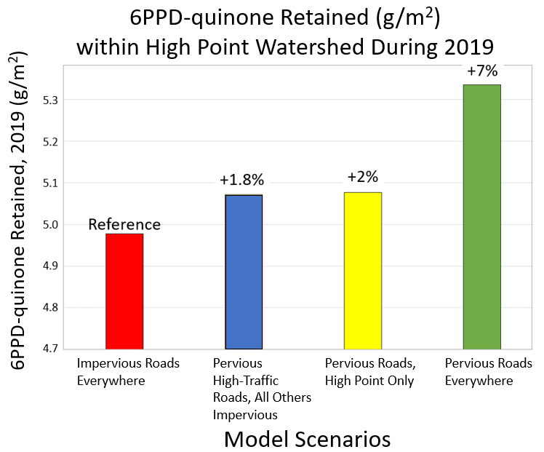
Simulated effects of pervious roads on 6PPD-quinone retention
Notes:
The four simulations demonstrate how 6PPD-quinone under these 4 pervious/impervious pavement scenarios may retain 6PPD-quinone within the Highpoint neighborhood.
Here we are looking at the simulated effects of the 4 pervious/impervious road scenarios on 6PPD-quinone retention 6PPD-quinone for 2019 in grams per meter for the Highpoint neighborhood subwatershed.
The red bar (left) is the reference scenario, for which VELMA was used to simulate impervious roads everywhere. Total 6PPD-quinone retained between January 1 and December 31 of 2019 was just below 5 grams per square meter.
The blue bar represents pervious high-traffic roads (35th Street) with all roads being impervious. The result is a 1.8% increase in 6PPD-quinone retention relative to the reference scenario (red).
The yellow bar represents pervious roads only in High Point (actual state). The result is a 2% increase in in 6PPD-quinone retention relative to the reference scenario (red).
The green bar represent pervious roads everywhere within the subwatershed, resulting in a 7% increase in 6PPD-quinone retention relative to the reference.
Additional analyses are underway to explore effects of other kinds of green and gray infrastructure treatments.
I (Jonathan) would like to pass it back to Bob for summarizing our results.
Note: All scenario results shown here are preliminary, representing our first attempt to use VELMA to simulated the effects described.

Slide 16
Summary of preliminary results
>99% of 6PPD-quinone reaching Longfellow Creek is via stormwater pipes.
Though modeled stream 6PPD-quinone concentrations are consistent with limited available grab sample data, confident use of VELMA for informing GI best practices awaits more extensive performance tests.
Current limited use of pervious pavements and rain gardens in the Longfellow watershed provides modest in-watershed retention of 6PPD-quinone loadings.
High “first flush” stormwater concentrations of 6PPD-quinone suggest that green and gray infrastructure treatments at pipe outfall (distal) locations – e.g., detention ponds and/or bioswales enhanced with activated carbon and microbial enrichment – could significantly decrease in-stream 6PPD-quinone concentrations.
Progress will continue to depend on collaboration of modelers, empirical researchers, and community stormwater managers.
US EPA Office of Research and Development
Center for Public Health and Environmental Assessment, Pacific Ecological Systems Division
16
Notes:
We want to emphasize that the modeling results presented here are preliminary and represent our first use of VELMA for simulating 6PPD-quinone fate and transport in any watershed. Work is in progress to refine and extend VELMA applications for 5 Puget Sound nearshore watersheds, all experiencing high rates of coho prespawn mortality.
Conclusions:
Over 99% of 6PPD-quinone reaching Longfellow creek is via storm water pipes. However, the simulations reported here constrained 6PPD deposition to roads with curbs and stormwater drains. Additional simulations will explore more diffuse deposition of 6PPD-quinone on AND near roadways (e.g., ditches).
Though modeled stream 6PPD-quinone concentrations are consistent with the currently available grab sample data, confident use of VELMA for informing GI best practices awaits more spatially and temporally extensive performance tests.
Current limited use of pervious pavements and rain gardens in the Longfellow watershed provides modest gains in retention of 6PPD-quinone loadings.
Very importantly, high “first flush” stormwater concentrations of 6PPD-quinone suggest that green and gray infrastructure treatments at pipe outfall (distal) locations – e.g., detention ponds and/or bioswales enhanced with activated carbon and microbial enrichment – could significantly decrease in-stream 6PPD-quinone concentrations.
We cannot emphasize our final point enough…progress to date and future progress will depend on collaboration of modelers, empirical researchers, and community storm water managers. We have been very fortunate to have the collaborators that we currently have, as summarized on the next slide.

Slide 17
Project Collaborators – Thank you!
EPA-ORD VELMA Team: Jonathan Halama (Spatial Synergy Solutions), Vivian Phan, Allen Brookes, Kevin Djang (Inoventures), Bob McKane
Other EPA-ORD: Paul Mayer, Matt Hopton, Brenda Rashleigh, Jim Markwiese, many others
EPA Region 10: Angela Adams, Rob Elleman, Mark Jankowski, Catherine Gockel, Lisa Chang, Michael Rylko, Rochelle Labiosa, Peter Murchie
University of WA Tacoma Center for Urban Waters: Ed Kolodziej, Kathy Peter, Zhenyu Tian, Joel Baker, Tessa Francis, Tarang Khangaonkar (PNNL, SSMC)
State of WA: Karen Dinicola (Ecology), Scott Redman (PSP)
King County: Matt Goehring et al.
City of Seattle: Catherine Wendland et al.
City of Burien: Dan O’Brien, Paige Morris
City of SeaTac: Dan Smith
Port of Seattle: Josh Feigin, Sarah Cox
City of Normandy Park: Amanda Leon
US EPA Office of Research and Development
Center for Public Health and Environmental Assessment, Pacific Ecological Systems Division
17
Notes:
Thanks everyone!
This slide concludes our talk.
Please contact Jonathan (halamaj@oregonstate.edu) or me (mckane.bob@epa.gov) if you have questions about any aspect of this work.

